Slide 1



HACKERWAR 4.0
ORGANISED BY
DEPARTMENT OF COMPUTER SCIENCE AND ENGINEERING FACULTY OF ENGINEERING AND TECHNOLOGY (ITER) SIKSHA ‘O’ ANUSANDHAN (DEEMED TO BE) UNIVERSITY, BHUBANESWAR, ODISHA

Slide 2
Basic Details of the Team and Problem Statement
Ministry/Organization Name/Student Innovation:
PS Code: SIH1287
Problem Statement Title: Use of Digital Technology to calculate water footprints for different daily use items .
Team Name: TechTonic
Team Leader Name: Sambhav Kumar Mohanty
Institute Code (AISHE):C42709
Institute Name: Siksha ‘O’ Anusandhan
Theme Name: Clean & Green Tecnology

Slide 3
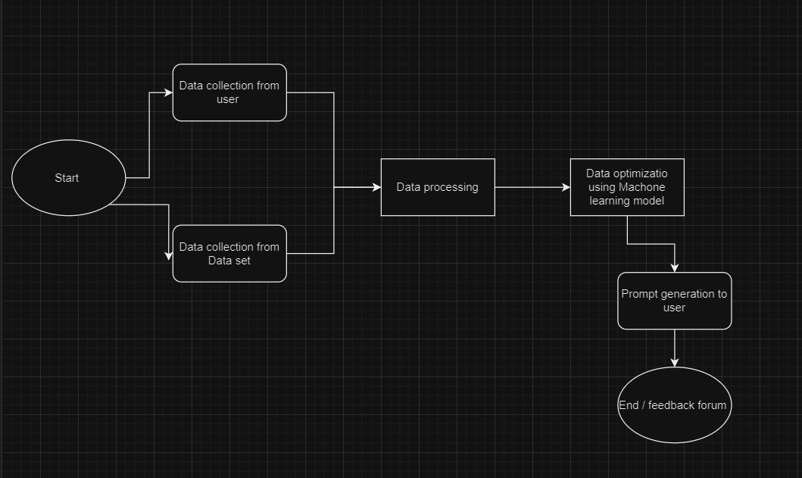

Idea/Approach Details
We are looking forward to make a website for water footprint calculation that will serve as a database for how much water is being used location wised. This will give us a better knowledge and more ideas for water conservation and effective water usage techniques.
The prototype function as follows:
User needs to enter there location.
Calculating footprints by scanning products using artificial intelligence(AI).
User can also calculate there daily water usage by answering the questions.
At end of the survey daily usage of the user will we calculated by a trained Machine Learning model.
This data will be stored in the database location wised.
Technology stack:

Slide 4
Idea/Approach Details
Describe your Use Cases here
Describe your Dependencies / Show stopper here
User may take snapshot of there products before using or buying them
Through ML model it’s water foot print will calculated.
If there is a water scarcity in that location through automation system nearby water resources will be shown to the user.
User may also get points if there monthly water uses decreases through proper conservation.
According to end result there will be prompts how we can adopt techniques for water conservation.
A multilingual website which will be available in 32 languages so that wide range of users can access it without any problem.
There will also be a chatbot support if user want proper details about installation any techniques of water conservation.
Location wise footprint can be used to spread awareness about proper usage.
Every users footprint will be added on the previous data for proper information.
Through points system user’s urge to use water conservation technique will increase.

Slide 5
Team Member Details
Team Leader Name: Sambhav Kumar Mohanty
Branch (Btech/Mtech/PhD etc):Btech Stream (ECE, CSE etc): CSE Year (I,II,III,IV): III
Team Member 1 Name: Debasish Bhola
Branch (Btech/Mtech/PhD etc): Btech Stream (ECE, CSE etc):CSE Year (I,II,III,IV): III
Team Member 2 Name: Roshali Sahoo
Branch (Btech/Mtech/PhD etc): Btech Stream (ECE, CSE etc): CSE Year (I,II,III,IV): III
Team Member 3 Name: Anandita Biswal
Branch (Btech/Mtech/PhD etc): Btech Stream (ECE, CSE etc): CSE Year (I,II,III,IV): III
Team Member 4 Name: Shreyosee Biswas
Branch (Btech/Mtech/PhD etc): Btech Stream (ECE, CSE etc): CSE Year (I,II,III,IV): III
Team Member 5 Name: Pritish Raj
Branch (Btech/Mtech/PhD etc): Btech Stream (ECE, CSE etc): CSE Year (I,II,III,IV): III
Team Mentor 1 Name: Type Your Name Here
Category (Academic/Industry): Expertise (AI/ML/Blockchain etc): Domain Experience (in years):
Team Mentor 2 Name: Type Your Name Here
Category (Academic/Industry): Expertise (AI/ML/Blockchain etc): Domain Experience (in years):

